Slide 1



TECHNO INDIA
UNIVERSITY
SHEcurity
SHEcurity
Navigating Success, Together on the Road of Women’s Safety
Neighborhood Safety & Alert Network (WEB-003)

Slide 2

India (2024): 31,677 cases reported (86 per day).
Major cities:
Delhi had the highest number of cases
While Kolkata reported a case On 9th August 2024, a 31-year-old
female postgraduate trainee doctor at R. G. Kar Medical College
and Hospital in Kolkata, was raped and murdered in a college building.
Her body was found in a seminar room on campus.
STATISTICAL ANALYSIS
Rajasthan, Madhya Pradesh, Maharashtra, West Bengal
https://hr.economictimes.indiatimes.com/news/workplace-4-0/diversity-and-inclusion/sexual-harassment-complaints-at-india-inc-rise-by-79-in-last-5-years/116137786
Under Indian law, using an object for self-defense against physical or sexual harassment is generally permissible, as actions taken in self-defense are not considered offenses, as stated in Section 96 of the Indian Penal Code (IPC).
Copyright © - Sandipan Saha.

Slide 3
PROBLEM STATEMENT
1. Threat of Physical Harassment
2. Lack of Immediate Help & Emergency Response
3. Inability to Share Real-Time Location to Family members
4. Limited Access to Effective Self-Defense or Defensive Tools
5. Unawareness of Nearby Police Stations & Help Centers
Copyright © - Sandipan Saha.

Slide 4
SHEcurity
TECHNO INDIA
UNIVERSITY
SHEcurity
The Ultimate Solution For This Problem Statement

Slide 5
SOLUTION STATEMENT
Modern High-Voltage Electric Taser: A pocket-friendly self-defense gadget with higher voltage
than standard tasers to incapacitate attackers instantly.
SOS Emergency Button: A dedicated button that, when pressed, sends an emergency SMS &
live location to guardians.
Voice-Activated Emergency Alert: By only saying "HELP" triggers an automatic emergency alert to guardians WITHOUT TOUCHING THE PHONE.
Real-Time Location Sharing: The web-application continuously tracks and shares the user’s
live location with registered contacts and show emergency services.
Nearby Police Station Locator: A built-in feature to find and contact the nearest police station
for immediate assistance.

Slide 6


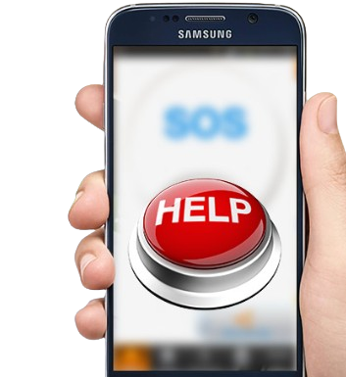
IMPLEMENTATION
SHEcurity
SPECIAL FEATURES :
Registration: NO Login at first trail / basic details to access safety services.
Login: NO Login at first trail / Secure user authentication.
Add - Mobile Number: Add emergency contacts for alert SMS
Update Geo-Location: Allow Real-time location on modernize SMS.
SOS Button - Emergency Alert : Instantly sends SMS and live location
to guardians even in offline through SMS.
Voice Support Activation: Activate by users voice by saying “Help”.
Search Nearby Police Station: Users can locate the nearest police station.

Slide 7

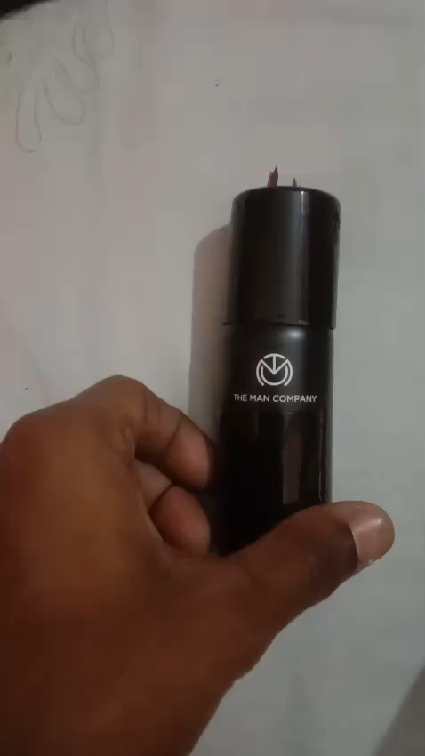
Iot DEVICE FUNCTION:
High-Voltage Electric Taser
Delivers a powerful electric shock to incapacitate attacker’s.
Automatically sends an emergency alert when activated.
SOS Emergency Button
Compact and POCKET-FRIENDLY for easy carrying.
C-Type charging, Last up-to 3 Executive MONTHS in a single charge.
High Voltage and Low AMPS & made with RECYCLED perfume Bottle.
Very Impactful Device Approved by STEP INCUBATION IIT KGP.
Click for Video

Slide 8
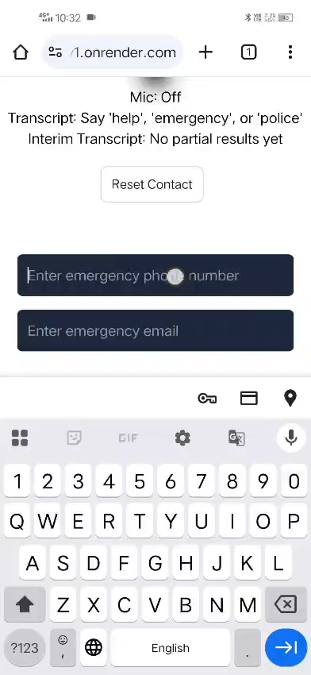
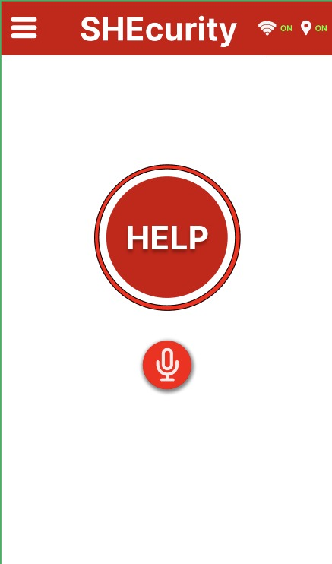


Software Requirements: -
Front End: React , Tailwind
Back End: Node JS
Control End: Express JS
Hardware Requirements: -
Voltage converter
DC – AC Transformer
Control Regulator
1000 mAh Lipo
Neo-6m Gps Module
Click here for Video

Slide 9
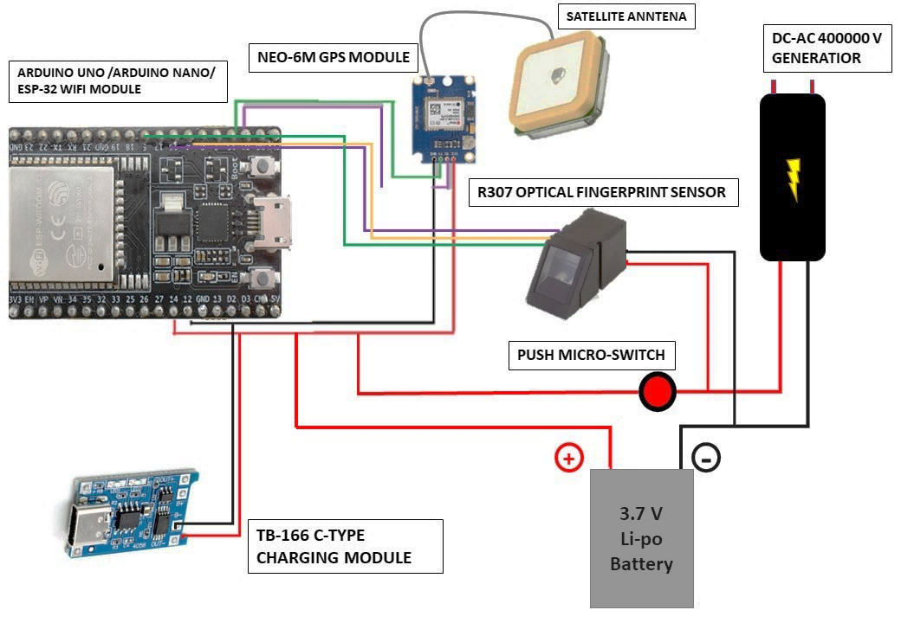
Iot DEVICE Circuit Diagram
Copyright © - Sandipan Saha.

Slide 10



CODE FULLY DEPLOYED
100% WORKING PROTOTYPE
SHEcurity
CLICK ME HERE
SHEcurity (Our Website Direct link)-
https://shecurity-static-v1.onrender.com/
GITHUB REPO- https://github.com/Sohamghosh98/Shecurity
YOUTUBE-
https://www.youtube.com/watch?v=GKjo4_ncg54
BACKEND- https://github.com/Sohamghosh98/Shecurity/tree/main/shecurity/backend
UI/UX- https://github.com/Sohamghosh98/Shecurity/tree/main/shecurity/frontend
Copyright © - Sandipan Saha.

Slide 11
TECHNO INDIA
UNIVERSITY
SHEcurity
THANK YOU

